Slide 1

CENTRAL INSTITUTE OF TECHNOLOGY KOKRAJHAR
Computer Science & Engineering Department-2023
Application of Machine Learning based approach for Diabetes Prediction
Project Members: | Amarjeet Kumar Singh (202002021073) Bhagyashree Nath (202002022099) Nerswn Baglary (202002022089)
Project Supervisor: | Dr. Pankaj Pratap Singh Assistant Professor (Senior Scale) Dept. of Computer Science & Engineering
Machine Learning based approach for Diabetes Prediction
April 24, 2023

Slide 2

OVERVIEW
Introduction
Motivation
Problem Statement
Objectives
Related Works
Proposed Mechanism
Machine Learning based approach for Diabetes Prediction
April 24, 2023

Slide 3
INTRODUCTION
Diabetes : A chronic disease that affects millions of people worldwide
Economic burden of Type 2 Diabetes (T2D) on society has increased over time
The number of people with diabetes rose from 108 million in 1980 to 422 million in 2014. Prevalence has been rising more rapidly in low- and middle-income countries than in high-income countries (source: WHO)
Early prediction of diabetes and prediabetes can reduce treatment costs and improve intervention
Life Insurance policy can be suggested with the help of this work
Health check up data taken as subject under test
A healthy diet, regular physical activity, maintaining a normal body weight and avoiding tobacco use are ways to prevent or delay the onset of type 2 diabetes.
Machine Learning based approach for Diabetes Prediction
April 24, 2023

Slide 4
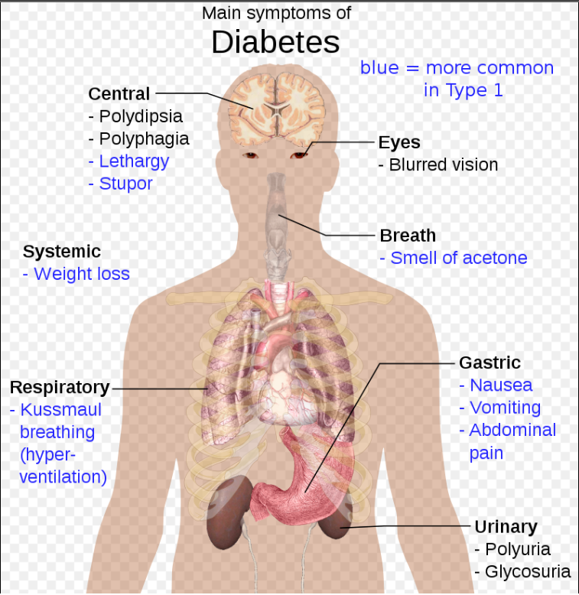
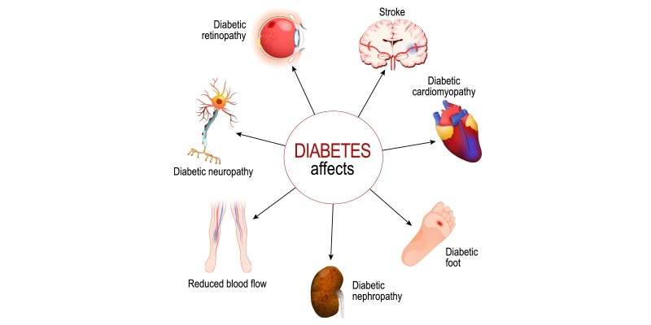
MOTIVATION
“ Trying to manage diabetes is hard because if you don’t, there are consequences you’ll have to deal with later in life ” - Bryan Adams
Sugar consumption: Too much sweetness is injurious to health
[Source: @Wikipedia]
[Source: rghospitals.com]
Machine Learning based approach for Diabetes Prediction
April 24, 2023

Slide 5
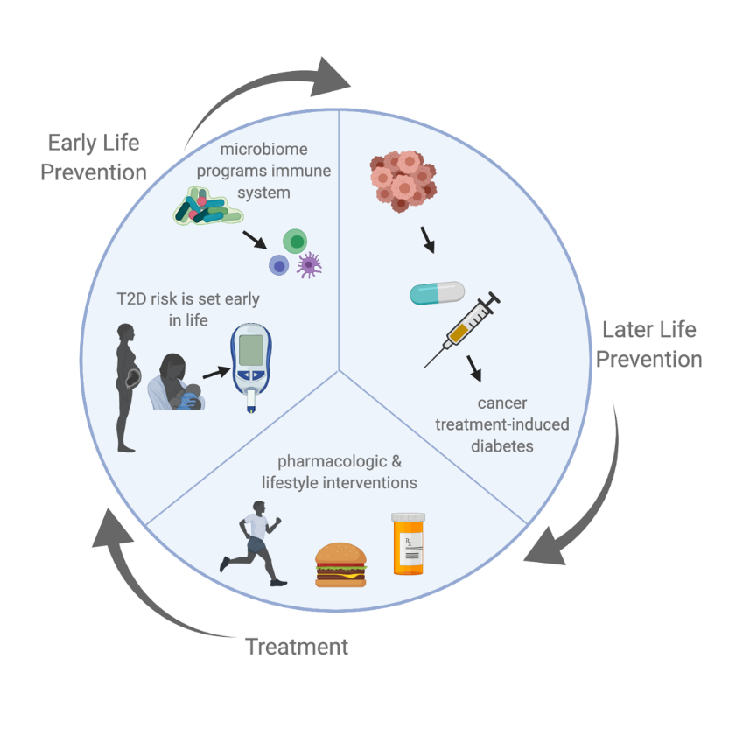
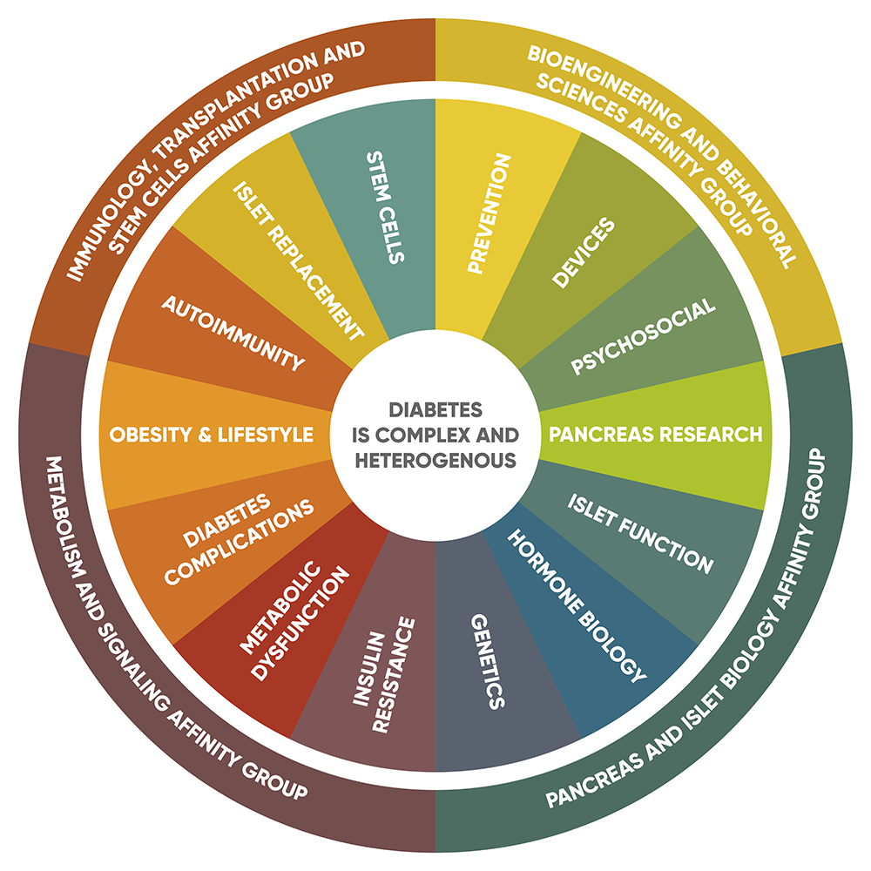
PROBLEM STATEMENT
Aim to reduce the death rate due to diabetes
Implementing latest technological advancements such as Machine learning & AI
Specific Life Insurance policy can be suggested to patient based on predicted result.
[Source: Stanford diabetes research center]
[Source: ouhealth.com ]
Machine Learning based approach for Diabetes Prediction
April 24, 2023

Slide 6
OBJECTIVES
The goal of this project is to develop a machine learning model that can accurately predict the likelihood of a person having diabetes based on various clinical features and give suggestion of relevant Insurance policy
The main objective of this project is to provide accurate predictions to assist doctors in diagnosing diabetes and provide early interventions for patients
Machine Learning based approach for Diabetes Prediction
April 24, 2023

Slide 7
EXISTING WORK
Md. Maniruzzaman et al (3) | Classifcation and prediction of diabetes disease using machine learning paradigm (Three sets of ML-based classifiers as Naïve Bayes(NB), Decision Tree(DT) & Adaboost( AB) is used) | 2020
Umair Muneer Butt et al (3) | Machine Learning Based Diabetes Classification and Prediction for Healthcare Applications (for the predictive analysis of diabetes, long short-term memory (LSTM), moving averages (MA), and linear regression (LR) is used) | 2021
Aishwarya Mujumdara et al (1) | Diabetes Prediction using Machine Learning Algorithms | 2019
Machine Learning based approach for Diabetes Prediction
April 24, 2023

Slide 8
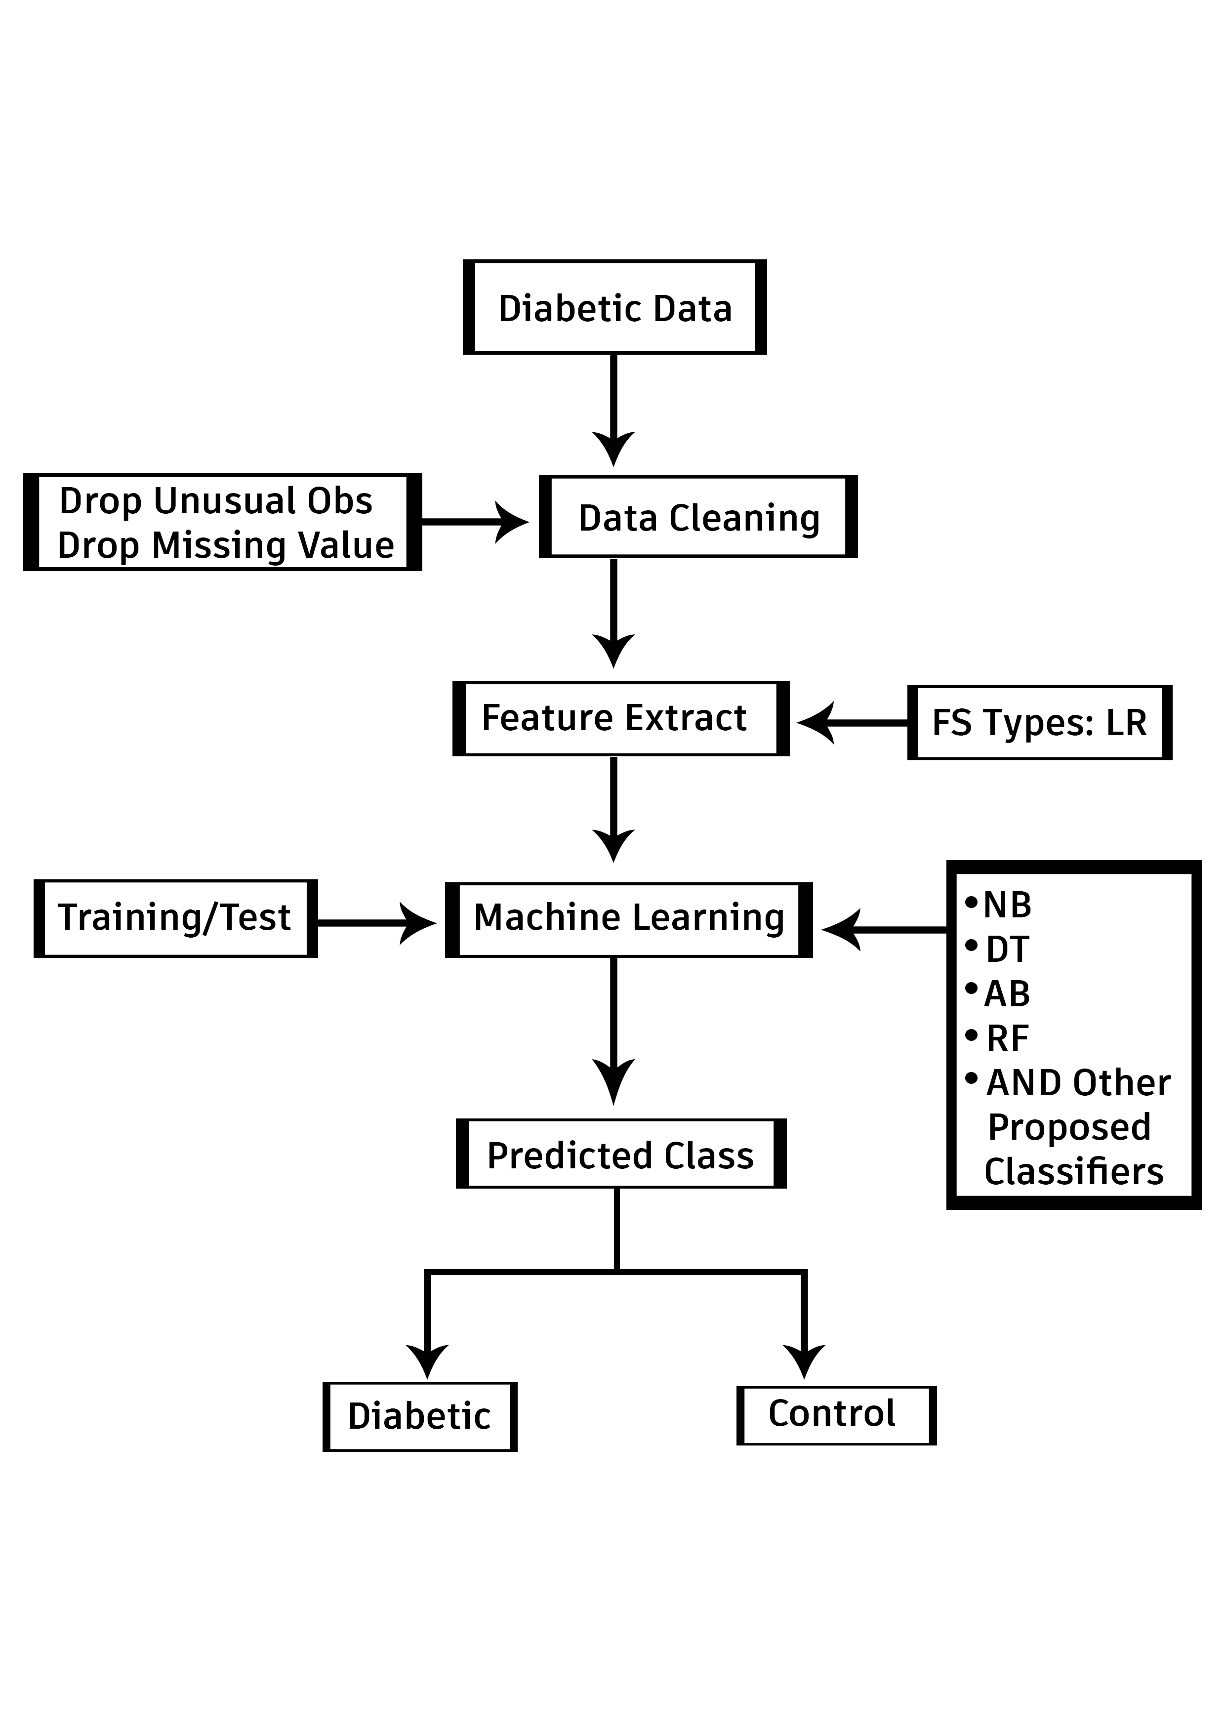
BLOCK DIAGRAM
Machine Learning based approach for Diabetes Prediction
April 24, 2023

Slide 9
PROPOSED MECHANISM
Dataset has been taken from Kaggle containing the values like Glucose level, Pregnancies, Blood Pressure etc.
Pre processing of data before going through the model has been done
80% data taken for training and 20% data taken for testing
Training model based on concept like SVM, random forest
Machine Learning based approach for Diabetes Prediction
April 24, 2023

Slide 10
PROPOSED MECHANISM
Logistic Regression
Various machine learning algorithms will be compared based on AUC & ROC, Till date we have trained model based on SVM and Logistic regression
Making application of prediction using result from model used
Evaluating the model whether it is right or not
Health policy suggestion to patient based on result
Machine Learning based approach for Diabetes Prediction
April 24, 2023

Slide 11
Thank You
Machine Learning based approach for Diabetes Prediction
April 24, 2023

